Slide 1

Information Visualization, aka Visual Analytics

Slide 2
Overview: Charts, Graphs, Visual Interfaces Help…
Provide a holistic sense of data as we load + analyze it:
Histograms, scatter plots, correlations, time series
Illustrate our algorithms’ performance:
Run time vs. data size, various machine learning parameters, etc.
Present information as part of a report or “dashboard”:
Figures illustrating performance

Slide 3
Information Visualization as a Field
Information visualization, a.k.a. visual analytics, is an entire research field
Major groups at U Washington (Jeff Heer), Stanford (Pat Hanrahan), Maryland (Ben Shneiderman)
Visual analytics is “the science of analytical reasoning supported by interactive visual interfaces.”
Data Analytics + Human-Computer Interaction + Perception + Computer Graphics
Often interactive visualizations
http://www.visual-analytics.eu/faq/

Slide 4
Effective Use of Visualization for Data Science
See Accompanying Lecture Notebook

Slide 5
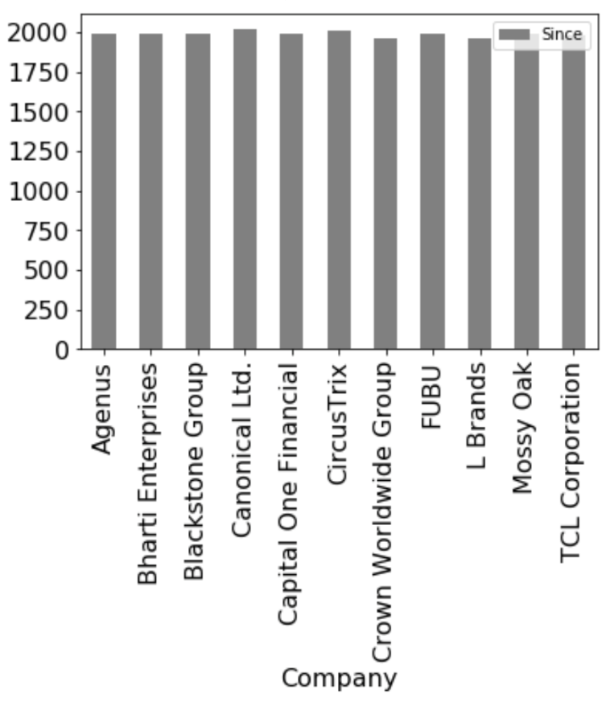
Matplotlib and Pandas are Closely Coupled: It’s Easy to Plot!
company_ceos_df = pd.read_html('https://en.wikipedia.org/wiki/List_of_chief_executive_officers#List_of_CEOs')[0]
# Split founding CEOs into separate dataframe
founders_df = company_ceos_df[company_ceos_df ['Title'].apply(lambda s: True if 'founder' in s.lower() else False)]
founders_df.plot(kind='bar', x='Company’, y='Since', color='gray')

Slide 6
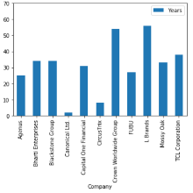
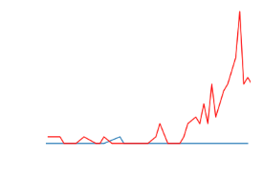
Decisions You’ll Need to Make
What kind of plot?
Usually line vs. bar charts (if based on complete data)
But… what if it’s statistical / sampled data?
What ranges and scales to use for the axes?
Do I normalize the data?

Slide 7
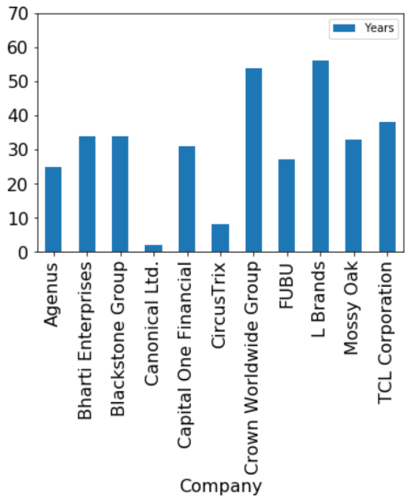
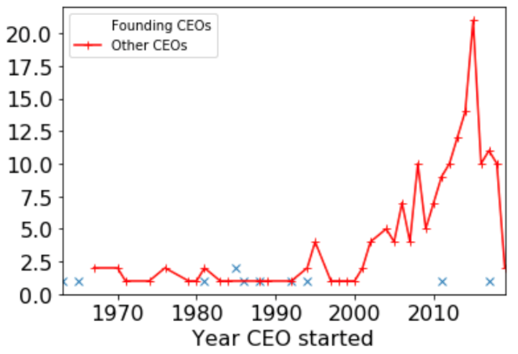
Bar vs. Line Charts
Consider categorical vs. continuous data on the x-axis and choose plots accordingly:
Bar charts → categorical (discrete valued, often non-numeric) data
Line charts → continuous data; the lines interpolated between points are meaningful! Note: if the data isn’t continuous, points are helpful to see
Notes:
We might plot, e.g., how long CEOs stay in their job. The companies are categorical, as shown on the left using a bar chart.
On the other hand, if we want to track how many CEOs started each year, the year becomes a continuous-valued feature where a line chart is more appropriate.
Pictorial?

Slide 8


Plotting and Axis Coordinates
How do we choose our axis min, max and scale (linear vs log)?
Key questions to ask yourself:
What gives the right intuitions about the phenomena you are plotting?
What lets the viewer visually compare / understand the phenomena?
Notes:
Suppose we want to know how long company founders stay as CEOs.
We can start by plotting the start year for every CEO – see what happens on the left. It’s very hard to distinguish entries here. Also, it’s a little unclear how to interpret this!
Of course, that is a very odd way to do things. On the right, we switch to how many years the CEO has been in the job, and we can see that a few CEOs have been there for a long time, and a few are very recent. Most have been CEOs for 20-30 years.

Slide 9
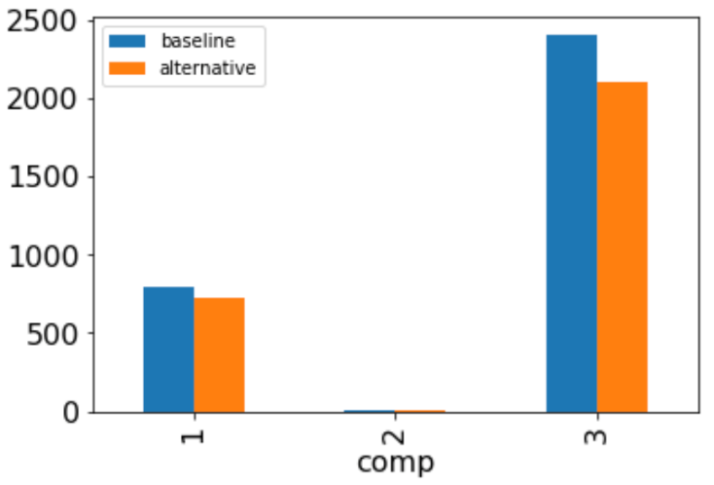
Normalizing Data
baseline_df = pd.DataFrame([{'comp': 1, 'value': 800}, {'comp': 2, 'value': 5}, {'comp': 3, 'value': 2400}])
alternative_df = pd.DataFrame([{'comp': 1, 'value': 720}, {'comp': 2, 'value': 3}, {'comp': 3, 'value': 2100}])
# We want to plot side-by-side
combined_df = baseline_df.rename(columns={'value': 'baseline'})
combined_df['alternative'] = overhead_df['value']
fig = combined_df.plot.bar(x='comp')
Notes:
Suppose we are plotting two different sets of performance numbers, e.g., from doing alternative big data computations over a set of computations (we’ll call them 1, 2, 3).
If we put these into a common dataframe and plot side-by-side, we’ll get the following graph. Note that it’s not
possible to understand what is going on in computation 2.

Slide 10
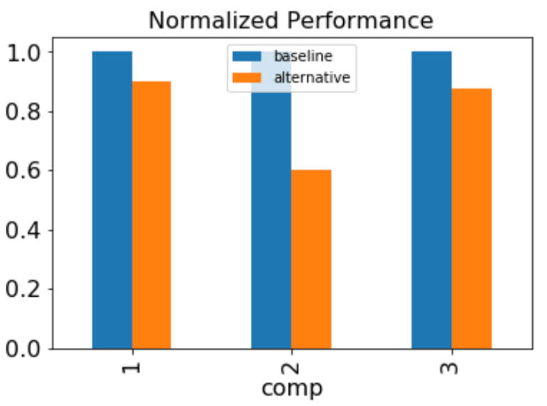
Normalizing Data
rescaled_df = combined_df.copy()
rescaled_df['alternative'] = combined_df.apply (lambda r: r['alternative'] / r['baseline'], axis=1)
rescaled_df['baseline'] = combined_df.apply (lambda r: 1.0, axis=1)
fig = rescaled_df.plot(kind='bar', x='comp')
fig.set_title('Normalized Performance')
Notes:
Here we have used apply to normalize the values against the performance of the baseline.

Slide 11
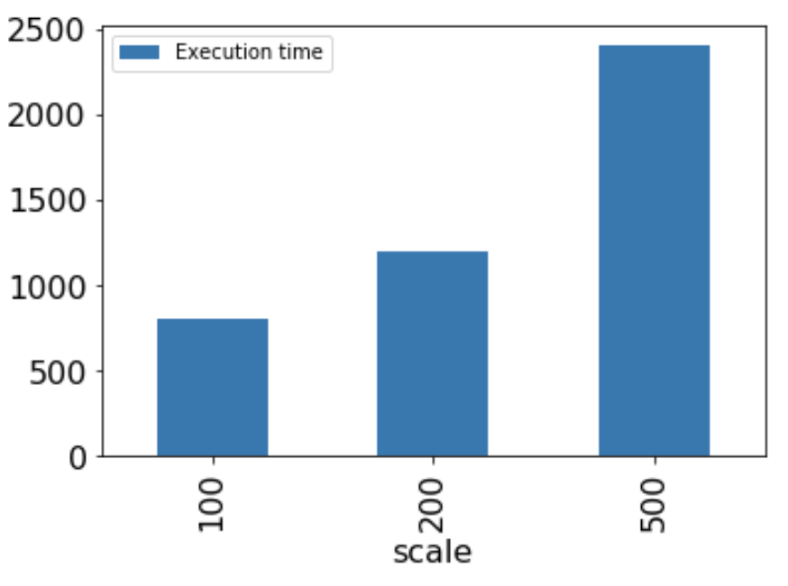
Question: What’s Wrong with this Figure?
Notes:
The use of inconsistent scaling between x-entries deceives the eye. If we look at the data as continuous-valued, we see it’s really a linear relationship.

Slide 12
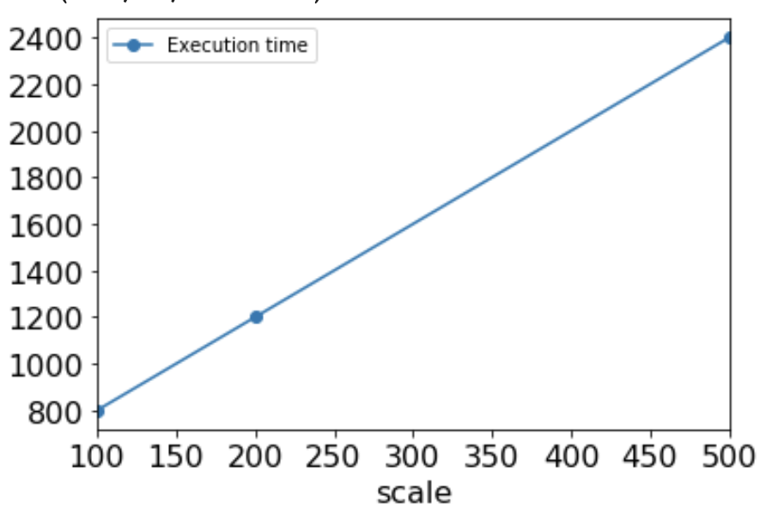
Question: What’s Wrong with this Figure?
The use of inconsistent scaling between x-entries deceives the eye.
If we look at the data as continuous-valued, we see it’s really a linear relationship.

Slide 13
Other Presentational Considerations
Interpretability – think carefully about scales, show confidence intervals for statistical measures
Readability
Adequate whitespace, plots are large enough to distinguish
For point-based methods, try to show the points
Font sizes – at least 20 pt for presentations, 9 pt for paper
Color
Pick visually distinctive but tonally compatible colors (e.g., from preconfigured palettes in visualization packages!)
Light text on dark background, or vice versa
Beware red/green and other forms of color blindness
Printability
Color may map to odd grayscales when printed!
Ensure shapes have solid (or dashed/dotted) outlines, so they are distinctive when printed

Slide 14
We’ve Been Using Matplotlib + Pyplot for Many Visualization Tasks
Basic graphing of data for Python
Scatter, line, bar charts
Can overlay onto other kinds of imaging (e.g. bitmapped images, Basemap maps)
Very powerful, composable, good out of the box defaults
Takes Numpy matrices, lists, Pandas DataFrames
Supports composition into subplots

Slide 15
https://www.kaggle.com/vitorscheffer/d/knityansuman/keystroke-dynamics/first-hand-exploration-of-the-data-using-svm
Raschka Ch. 10
https://www.kaggle.com/sanjaytiwari/d/usgs/earthquake-database/mapping-of-earthquake-and-its-analysis
Raschka Ch. 10

Slide 16
Raschka Ch. 10
https://matplotlib.org/examples/api/barchart_demo.html

Slide 17
Summary of General Rules of Thumb
Think carefully about the kind of data you are showing:
What are the dimensions? Is there a way of mapping into a meaningful coordinate space?
Should we think of the dimensions as categorical or continuous?
What are the phenomena to compare to each other?
Do we want to show two or more items side-by-side on the same scale?
Understand what the underlying phenomena is, then figure out:
The right scale and coordinates to show the intuition
Whether to normalize the data

Slide 18
Visualization in Machine Learning

Slide 19
Concerns When We Get to Machine Learning (We’ll Revisit Soon!)
Which algorithms work better?
Plot different strategies according to performance measures
Which (hyper)parameter settings should I use?
Plot parameter settings and their performance, find the optimal
How many dimensions are inherent in the data?
How much data should I use to train the machine learning algorithm?
… All of this is upcoming!

Slide 20
Fundamentals of Visualization

Slide 21
A Key Question
We have gone over some of the basics of choosing things like axes, normalizing data, and determining the type of plot.
Is there a more general set of principles for choosing and composing different features, to pick a particular visualization?

Slide 22
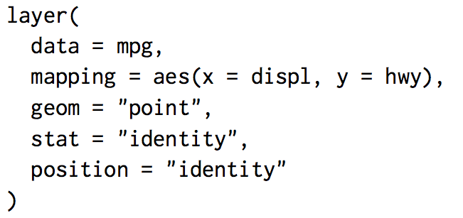
“Grammar of Graphics” - Leland Wilkinson, ggplot2 for R, 2005
Basis of R’s ggplot2
Divides plots into:
layers
data
aesthetic mappings
geometric objects
statistical transformations
position adjustments
scales
coordinate system
facets (groups)
Notes:
From https://www.dataplusscience.com/files/21-grammar-of-graphics.pdf

Slide 23
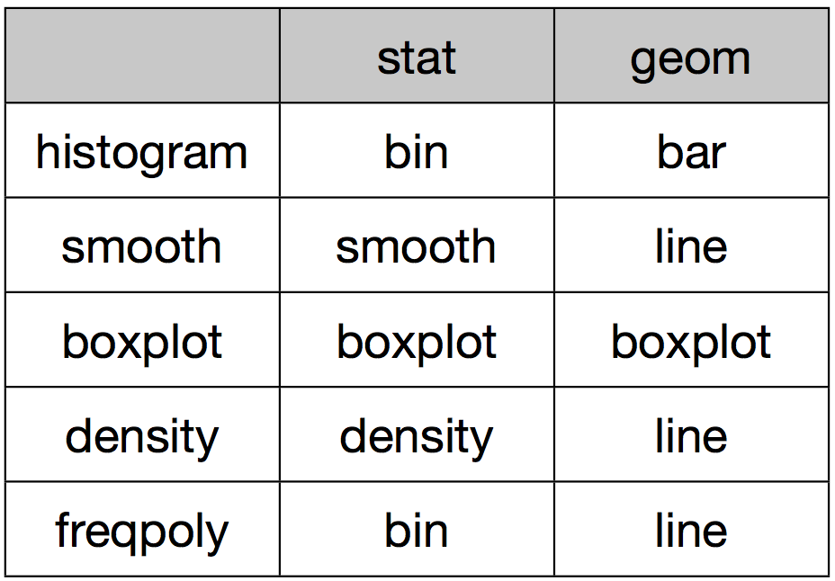
Examples of Statistical Transformations and Geometric Mappings
Notes:
As examples, histogram uses binning as a statistical process over the data, and displays the geometry as a bar.
A density plot does a density analysis and uses lines to render this.
etc.

Slide 24
ggplot2 and Python
In Python: ggplot emulates ggplot2 – you can use this directly
But more broadly, many of the ideas show up in other libraries and packages
from ggplot import *
ggplot(rescaled_df, aes(x='comp', y='alternative')) + geom_line() + stat_smooth()

Slide 25
Trends
Can we (semi) automate the process of choosing the right visualization?
To some extent, commercial products like Tableau help with this
Recent work (e.g., Draco by Moritz et. al.) suggests there may be a path towards at least a recommender system for visualization, based on data properties and general “rules of thumb” expressed as soft and hard constraints

Slide 26
More Advanced Visualization in Python

Slide 27
Beyond Matplotlib
Matplotlib doesn’t really focus on data that is statistical in nature (e.g., show confidence intervals, correlations)
For improved visualizations:
Seaborn – Matplotlib/pyplot extensions for statistical data

Slide 28
Plotting Statistical & Correlational Data with Seaborn
https://seaborn.pydata.org/

Slide 29
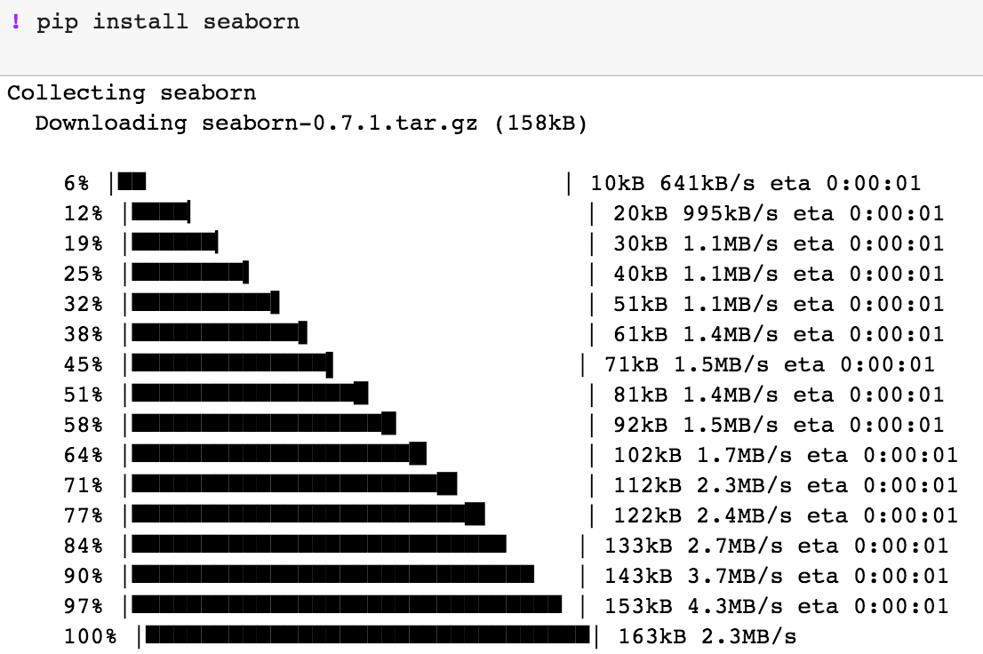
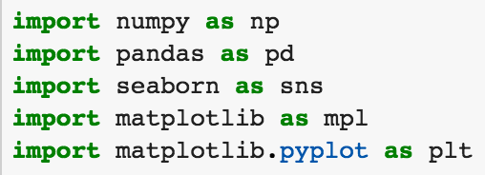
What is Seaborn?
An extension to matplotlib with:
Built-in themes for colors, etc.
Visualizing univariate + bivariate distributions
Tools for linear regression
Matrix visualization
Statistical timeseries data
Grids of plots

Slide 30
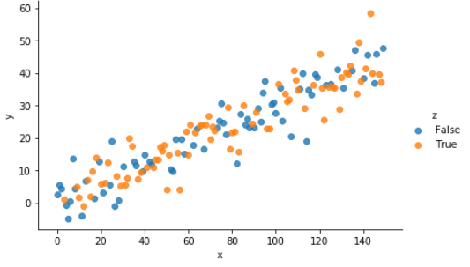
Scatter Plot with Seaborn
# Some simple data, random points
points = 150
slope = 0.3 x = np.array(range(points))
# We'll plot these
y = np.random.randn(points) * 5 + x * slope
# Choose random int, set z to True if positive, else z False
z = map(lambda x: x >= 0, np.random.randn(points)) sample_df = pd.DataFrame({'x': x, 'y': y, 'z': z})
# Scatter plot, height 4, shading the points based on if z is True
sb.lmplot('x', 'y', data=sample_df, height=4, aspect=3, fit_reg=False, hue="z")

Slide 31
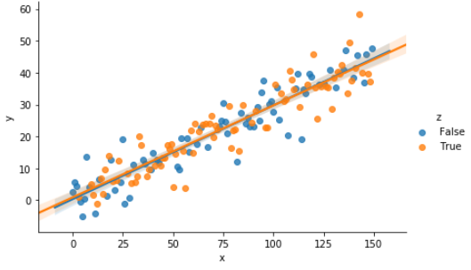
Scatter Plot with Seaborn with Regression Line
# Some simple data, random points
points = 150
slope = 0.3 x = np.array(range(points))
# We'll plot these
y = np.random.randn(points) * 5 + x * slope
# Choose random int, set z to True if positive, else z False
z = map(lambda x: x >= 0, np.random.randn(points)) sample_df = pd.DataFrame({'x': x, 'y': y, 'z': z})
# Scatter plot, height 4, shading the points based on if z is True
sb.lmplot('x', 'y', data=sample_df, height=4, aspect=3, fit_reg=True, hue="z")

Slide 32
Understanding Data Relationships with Seaborn: How Much Do People Tip?
Let’s start with the FacetGrid, which is a bit like a visual GROUP BY
# Question: how do people tip on different days of the week?
tips_dataset['tip_pct’] = tips_dataset.apply(lambda r: r['tip']/r['total_bill’], axis=1)
# Create different graph for each 'time’ value (lunch vs dinner)
g = sb.FacetGrid(tips_dataset, col='time', hue='day’, height=4, aspect=1)
# Plot total bill vs. tip within each graph
g.map(plt.scatter, 'total_bill', 'tip_pct')
g.add_legend()
Notes:
Here we’ve split lunch vs dinner, and looked at the day of the week (in case a Friday or weekend changes things).
What do you see? Any ideas why?
[Note Thursday has bigger total bills, perhaps bigger sizes? Then show the day vs size plot.]

Slide 33
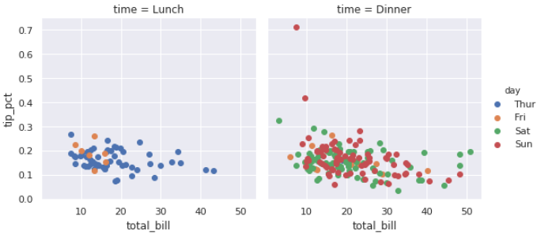
Understanding Data Relationships with Seaborn: How Much Do People Tip?
Let’s start with the FacetGrid, which is a bit like a visual GROUP BY
# Question: how do people tip on different days of the week?
tips_dataset['tip_pct’] = tips_dataset.apply(lambda r: r['tip']/r['total_bill’], axis=1)
# Create different graph for each 'time’ value (lunch vs dinner)
g = sb.FacetGrid(tips_dataset, col='time', hue='day’, height=4, aspect=1)
# Plot total bill vs. tip within each graph
g.map(plt.scatter, 'total_bill', 'tip_pct')
g.add_legend()
Notes:
Here we’ve split lunch vs dinner, to see if they are different. We know that dinner is generally a more expensive meal, and we might expect that business lunches are proportionally more common than business dinners.
Here we’ve also used color to compare the day of the week (in case a Friday or weekend changes things).
What do you see? Any ideas why?
[Note Thursday has bigger total bills, perhaps bigger sizes? Then show the day vs size plot.]

Slide 34
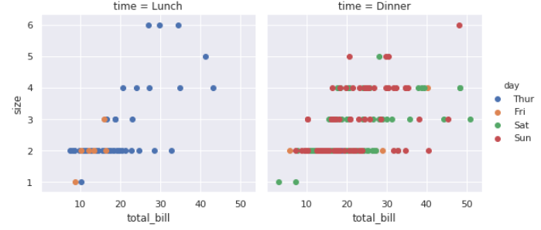
Understanding Data Relationships with Seaborn: How Much Do People Tip?
Let’s start with the FacetGrid, which is a bit like a visual GROUP BY
# Question: how do people tip on different days of the week?
tips_dataset['tip_pct’] = tips_dataset.apply(lambda r: r['tip']/r['total_bill’], axis=1)
# Create different graph for each 'time’ value (lunch vs dinner)
g = sb.FacetGrid(tips_dataset, col='time', hue='day’, height=4, aspect=1)
# Plot total bill vs. tip within each graph
g.map(plt.scatter, 'total_bill', 'tip_pct')
g.add_legend()
34

Slide 35
Pairgrids: Pairwise Comparisons
# Let's look at how different
factors are influenced by
the size of the party
sb.pairplot(data=tips_dataset,
kind='scatter’,
hue='size')

Slide 36
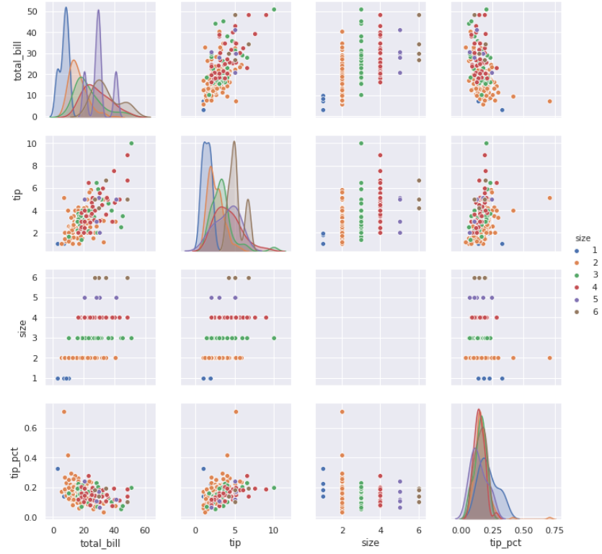
Pairgrids: Pairwise Comparisons
# Let's look at how different
factors are influenced by
the size of the party
sb.pairplot(data=tips_dataset,
kind='scatter’,
hue='size')

Slide 37
How Much Is a Typical Bill, by Group Size? Heatmaps
# Create histogram bins of size 5
bins = np.arange(tips_dataset.total_bill.min(), tips_dataset.total_bill.max(), 5)
# Cut the bins, and group by size
by_bill_binned = tips_dataset.groupby([pd.cut(tips_dataset.total_bill, bins, precision=0),'size']).size().unstack().fillna(0)
sb.heatmap(by_bill_binned[by_bill_binned.sum(axis=1) > 3])

Slide 38
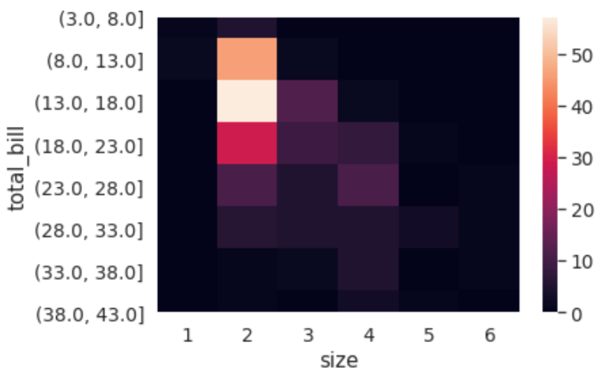
How Much Is a Typical Bill, by Group Size? Heatmaps
# Create histogram bins of size 5
bins = np.arange(tips_dataset.total_bill.min(), tips_dataset.total_bill.max(), 5)
# Cut the bins, and group by size
by_bill_binned = tips_dataset.groupby([pd.cut(tips_dataset.total_bill, bins, precision=0),'size']).size().unstack().fillna(0)
sb.heatmap(by_bill_binned[by_bill_binned.sum(axis=1) > 3])

Slide 39
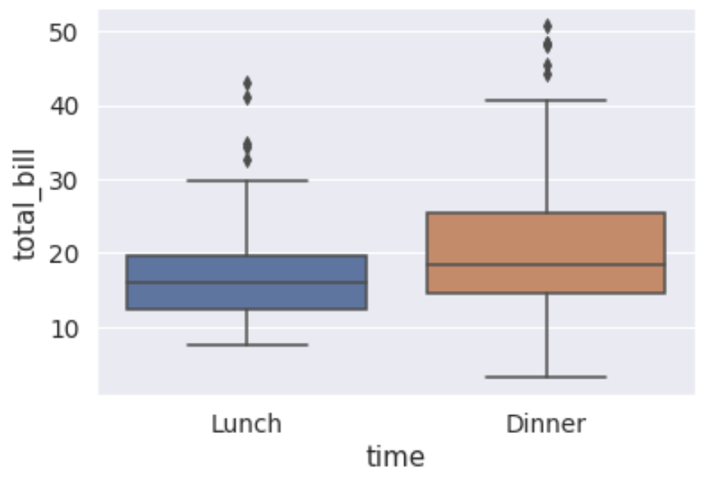
Box-and-Whiskers
sb.boxplot(tips_dataset.time, tips_dataset.total_bill)
Outliers
Maximum
Upper Quartile (med of upper half)
Median
Lower Quartile (med of lower half)
Minimum

Slide 40
Seaborn and Visualizing Statistical Data
Seaborn builds upon matplotlib with a focus on statistical data
Scatter plots with fitting and confidence intervals:
Key for understanding (linear) trends
Grids for finding attribute-to-attribute correlations:
Incredibly useful for finding correlations by eye
Heatmaps:
Show popular aspects
Box-and-whiskers (and variants e.g., violin plots):
Show where data is commonly distributed
Each of these has an important place in the data scientist’s toolbox!

